Slide 1
Unit-2 Part A Introduction to cloud computing
Abhishek Bhattacherjee

Slide 2
Contents
Cloud Computing in a Nutshell
Roots of Cloud Computing
Layers and Types of Clouds
Desired Features of a Cloud
Cloud Infrastructure Management
Examining the Characteristics of Cloud Computing

Slide 3
Cloud computing is more than a service, sitting in some remote data centre. It’s a set of approaches that can help organizations quickly, effectively add and subtract resources in almost real time.

Slide 4
Cloud Computing
In Simplest terms, cloud computing means storing and accessing the data and programs on remote servers that are hosted on the internet instead of the computer’s hard drive or local server. Cloud computing is also referred to as Internet-based computing.
What is Cloud Computing?
The term “Cloud Computing” generally refers to the ability of a system to store data or applications on remote servers, process data or applications from servers, and access data and applications via the Internet. Cloud computing provides scalability, flexibility, cost-effectiveness, and security to individuals and organizations to manage their IT operations. Cloud computing works on a Pay-on-Use basis for individuals and organizations. It is an on-demand availability of system resources and computing power without direct active management by the user.

Slide 5
Cloud computing in nutshell
Technologies such as cluster, grid, and now, cloud computing, have all aimed at allowing access to large amounts of computing power in a fully virtualized manner.
Consumers pay providers based on usage (“pay-as-you-go”), similar to the way in which we currently obtain services from traditional public utility services such as water, electricity, gas, and telephony.

Slide 6
Cloud computing has been coined as an umbrella term to describe a category of sophisticated on-demand computing services initially offered by commercial providers, such as Amazon, Google, and Microsoft.
It denotes a model on which a computing infrastructure is viewed as a “cloud,” from which businesses and individuals access applications from anywhere in the world on demand
The main principle behind this model is offering computing, storage, and software “as a service.”

Slide 7
Cloud computing is the result of many years of evolution dating back to the first computers. It is the natural progression from the centralized mainframe era, to the distributed client-server era enabled by the birth of personal computers, to the Internet era where the enterprise was able to connect to the rest of the world through a network of computers that spanned the globe.

Slide 8
In October 2010, a photo-sharing application called Instagram was launched, and 25,000 people registered on that first day. Three months later, Instagram had 1 million users, and shortly after hit 10 million. At that time, the company only offered an iOS version of its mobile application, so it was only capturing iPhone users. Would it have been possible that a normal traditional server would have supported that kind of traffic?

Slide 9
Cloud Computing
Cloud computing consists of multiple servers that host web services and data storage. This technology allows companies to eliminate the need for expensive and powerful computers.
In the traditional system, the company owns and maintains physical hardware, which costs much more, while cloud computing delivers a virtual platform.
Cloud computing has many applications, like infrastructure management, application execution, and data access management.

Slide 10
Question?
Which Cloud Platform and services are used by Social Media Apllications like Facebook, Instagram, Twitter etc?

Slide 11
ROOTS OF CLOUD COMPUTING
We can track the roots of clouds computing by observing the advancement of several technologies, especially in hardware (virtualization, multi-core chips), Internet technologies (Web services, service-oriented architectures, Web 2.0), distributed computing (clusters, grids), and systems management (autonomic computing, data center automation).

Slide 12
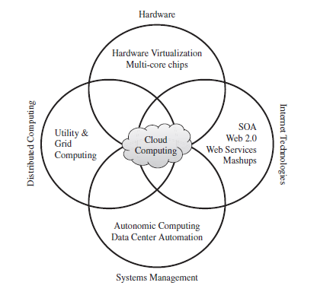

Slide 13
This model brings benefits to both consumers and providers of IT services. Consumers can attain reduction on IT-related costs by choosing to obtain cheaper services from external providers as opposed to heavily investing on IT infrastructure and personnel hiring. The “on-demand” component of this model allows consumers to adapt their IT usage to rapidly increasing or unpredictable computing needs.

Slide 14
Web services can glue together applications running on different messaging product platforms, enabling information from one application to be made available to others, and enabling internal applications to be made available over the Internet.
The purpose of a SOA is to address requirements of loosely coupled, standards-based, and protocol-independent distributed computing users.

Slide 15
Companies actively use web services for common tasks, for instance, when integrating payments to their platforms or while registering users on a new website via Facebook or Google credentials.
Asking Siri or Alexa the weather forecast and using Google Maps are other examples of web services in a day-to-day routine.

Slide 16
Root 1: Internet Technologies
The first root is Internet Technologies from the roots of cloud computing which contains service-oriented architecture (SOA), web 2.0, and web services.
Internet technologies are widely accessible to the public. People can access the content and run applications that depend on the network connection.

Slide 17
Service-oriented Architecture, or SOA, is a self-contained module specially designed for business functionalities.
As the business grows, there is a large number of implementation of software and hardware requirements, which is difficult to manage. Hence SOA helps to maintain and implement the architecture.
Web Services like XML and HTTP provide web delivery services using common mechanisms. It is a universal concept of web service all over the world.
WEB 2.0 Services are more convenient for the users, as they do not have to learn more about coding and concepts to work with it.

Slide 18
Some examples of WEB 2.0 services are host services like Google Maps, microblogging sites like Twitter, and social networking sites like Facebook.

Slide 19
In a SOA, software resources are packaged as “services,” which are well-defined, self-contained modules that provide standard business functionality and are independent of the state or context of other services. Services are described in a standard definition language and have a published interface.
Programmable Web is a public repository of service APIs and mashups currently listing thousands of APIs and mashups.

Slide 20
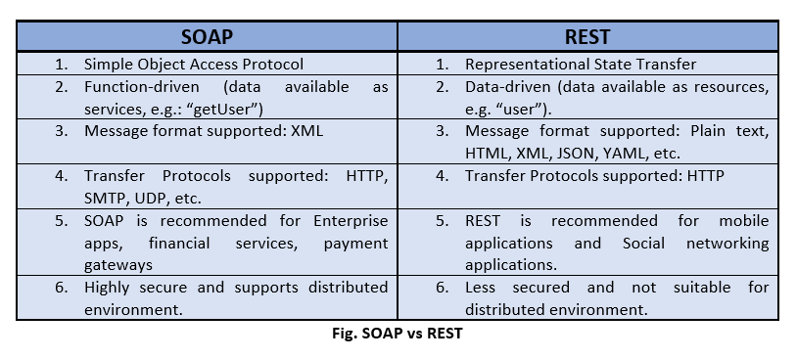
In the consumer Web, information and services may be programmatically aggregated, acting as building blocks of complex compositions, called service mashups. Many service providers, such as Amazon, del.icio.us, Facebook, and Google, make their service APIs publicly accessible using standard protocols such as SOAP(Simple Object Access Protocol) and REST(Representational state transfer)

Slide 21
Distributed Computing
The second root is Distributed Computing from the roots of cloud computing which contains grids, utility computing, and cluster.
for example, a computer is a general store and documents in the form of files.
Each document stored in the computer has a specific location, either on the local hard disk or it is stored over the internet.
Now, when someone visits your website over the internet, they browse through the files on the browser without downloading them.

Slide 22
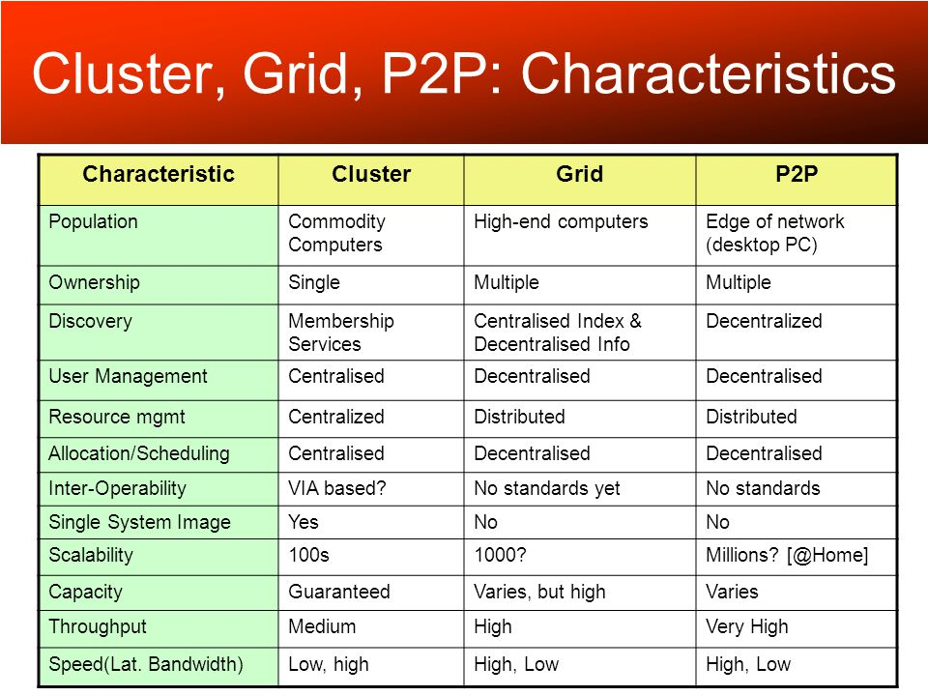
A key aspect of the grid computing services in roots to cloud has been building standard Web services-based protocols that allow distributed resources to be “discovered, accessed, allocated, monitored, accounted for, and billed for, etc., and in general managed as a single virtual system.

Slide 23
Root 3: Hardware
The third root is Hardware from the roots of cloud computing which contains multi-core chips and virtualization.
Generally, computers require hardware such as CPU, RAM, ROM, and Motherboard to process, store, analyze, and manage the data.
There are no hardware devices or components in Cloud Computing because the applications are managed via the internet.

Slide 24
In cloud computing, virtualization allows users to use resources from multiple virtual machines. It makes it easier and cheaper for customers to use cloud services.
In short, a single cloud computing platform provides all the requirements of hardware, software, and operating system.

Slide 25
The idea of virtualizing a computer system’s resources, including processors, memory, and I/O devices, has been well established for decades, aiming at improving sharing and utilization of computer systems.
The advent of several innovative technologies—multi-core chips, para virtualization, hardware-assisted virtualization, and live migration of VMs—has contributed to an increasing adoption of virtualization on server systems

Slide 26
Root 4: System Management
The fourth root of cloud computing (System Management) contains data centre automation and autonomic computing.
System management handles the operations to improve the productivity and efficiency of the system.
To achieve this, management ensures all employees have easy access to all the necessary information.
In an autonomic system, admin work becomes easier as the system is autonomic or self-managing. Additionally, data analysis and monitoring are handled by the sensors.

Slide 27
Data center automation is the process by which routine workflows and processes of a data center—scheduling, monitoring, maintenance, application delivery, and so on—are managed and executed without human administration.

Slide 28
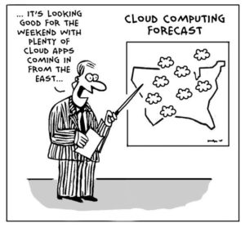

Slide 29
Cloud is a parallel and distributed computing system consisting of a collection of inter-connected and virtualised computers that are dynamically provisioned and presented as one or more unified computing resources based on service-level agreements (SLA) established through negotiation between the service provider and consumers. -Rajkumar buyya

Slide 30
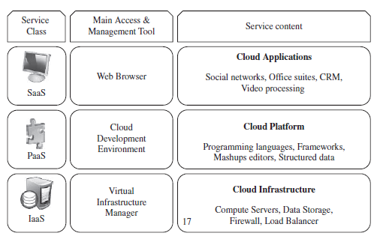
Types of cloud

Slide 31
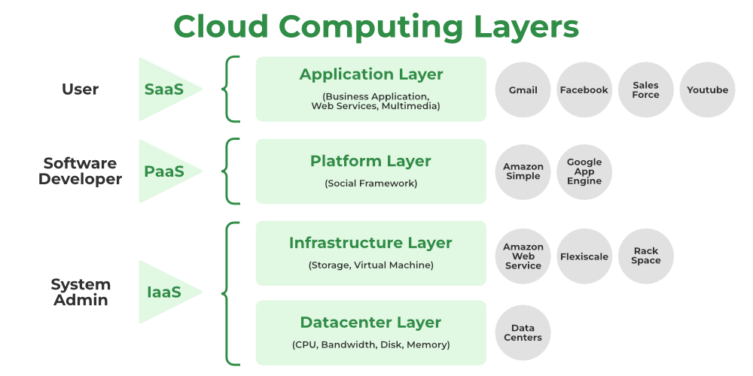

Slide 32
Cloud computing services are divided into three classes, according to the abstraction level of the capability provided and the service model of providers, namely:
(1) Infrastructure as a Service
(2) Platform as a Service
(3) Software as a Service

Slide 33
These are sometimes called the cloud computing stack because they are built on top of one another.
These abstraction levels can also be viewed as a layered architecture where services of a higher layer can be composed from services of the underlying layer i.e, SaaS can provide Infrastructure.
Cloud development environments are built on top of infrastructure services to offer application development and deployment capabilities; in this level, various programming models, libraries, APIs, and mashup editors enable the creation of a range of business, Web, and scientific applications.

Slide 34
*Note: Mashups Editors:-
to provide a visual interface to build up a mashup. -often it allows the user to drag & drop data points into a web application

Slide 35
Infrastructure-as-a-service
Infrastructure as a Service (IaaS) is the delivery of computer hardware (servers, networking technology, storage, and data center space) as a service. It may also include the delivery of operating systems and virtualization technology to manage the resources.
Dynamic scaling as applied to infrastructure means that the infrastructure can be automatically scaled up or down, based on the requirements of the application.

Slide 36
IaaS is a service where infrastructure is provided as outsourcing to enterprises such as networking equipment, devices, database, and web servers.
It is also known as Hardware as a Service (HaaS).
It simply provides the underlying operating systems, security, networking, and servers for developing such applications, and services, and deploying development tools, databases, etc.

Slide 37
The various companies providing Infrastructure as a service are Amazon web services, Bluestack, IBM, Openstack, Rackspace, and Vmware.

Slide 38
Platform-as-a-service
With Platform as a Service (PaaS), the provider delivers more than infrastructure. It delivers what you might call a solution stack — an integrated set of software that provides everything a developer needs to build an application — for both software development and runtime.
PaaS can be viewed as an evolution of Web hosting. In recent years, Webhosting companies have provided fairly complete software stacks for developing Websites.

Slide 39
Platform as a Service
PaaS is a category of cloud computing that provides a platform and environment to allow developers to build applications and services over the internet.
PaaS services are hosted in the cloud and accessed by users simply via their web browser.
The consumer does not manage or control the underlying cloud infrastructure including network, servers, operating systems, or storage, but has control over the deployed applications and possibly configuration settings for the application-hosting environment.

Slide 40
PaaS, or Platform-as-a-Service, is a cloud computing model that provides customers a complete cloud platform—hardware, software, and infrastructure—for developing, running, and managing applications without the cost, complexity, and inflexibility that often comes with building and maintaining that platform on-premises.
The PaaS provider hosts everything—servers, networks, storage, operating system software, databases, development tools—at their data center.

Slide 41
Example:an annual day function, you will have two options either to create a venue or to rent a venue but the function is the same.
The various companies providing Platform as a service are Amazon Web services Elastic Beanstalk, Salesforce, Windows Azure, Google App Engine, cloud Bees and IBM smart cloud.
PaaS providers manage the bulk of your cloud computing services, such as servers, runtime and virtualization. As a PaaS customer, your company maintains management of applications and data.

Slide 42
Software-as-a-service
One of the first implementations of cloud services was Software as a Service (SaaS) — business applications that are hosted by the provider and delivered as a service.
At the top of the stack is SaaS. SaaS is a complete application delivered as a service to the service consumer. The service consumer has only to configure some application-specific parameters and manage users.

Slide 43
Software as a Service
Software-as-a-Service (SaaS) is a way of delivering services and applications over the Internet. Instead of installing and maintaining software, we simply access it via the Internet, freeing ourselves from the complex software and hardware management.
It removes the need to install and run applications on our own computers or in the data centers eliminating the expenses of hardware as well as software maintenance.

Slide 44
Most SaaS applications can be run directly from a web browser without any downloads or installations required.
SaaS (sometimes called cloud application services) is cloud-hosted, ready-to-use application software.
Users pay a monthly or annual fee to use a complete application from within a web browser, desktop client or mobile app.
Email, social media, and cloud file storage solutions (such as Dropbox or Box) are examples of SaaS applications people use every day in their personal lives.

Slide 45
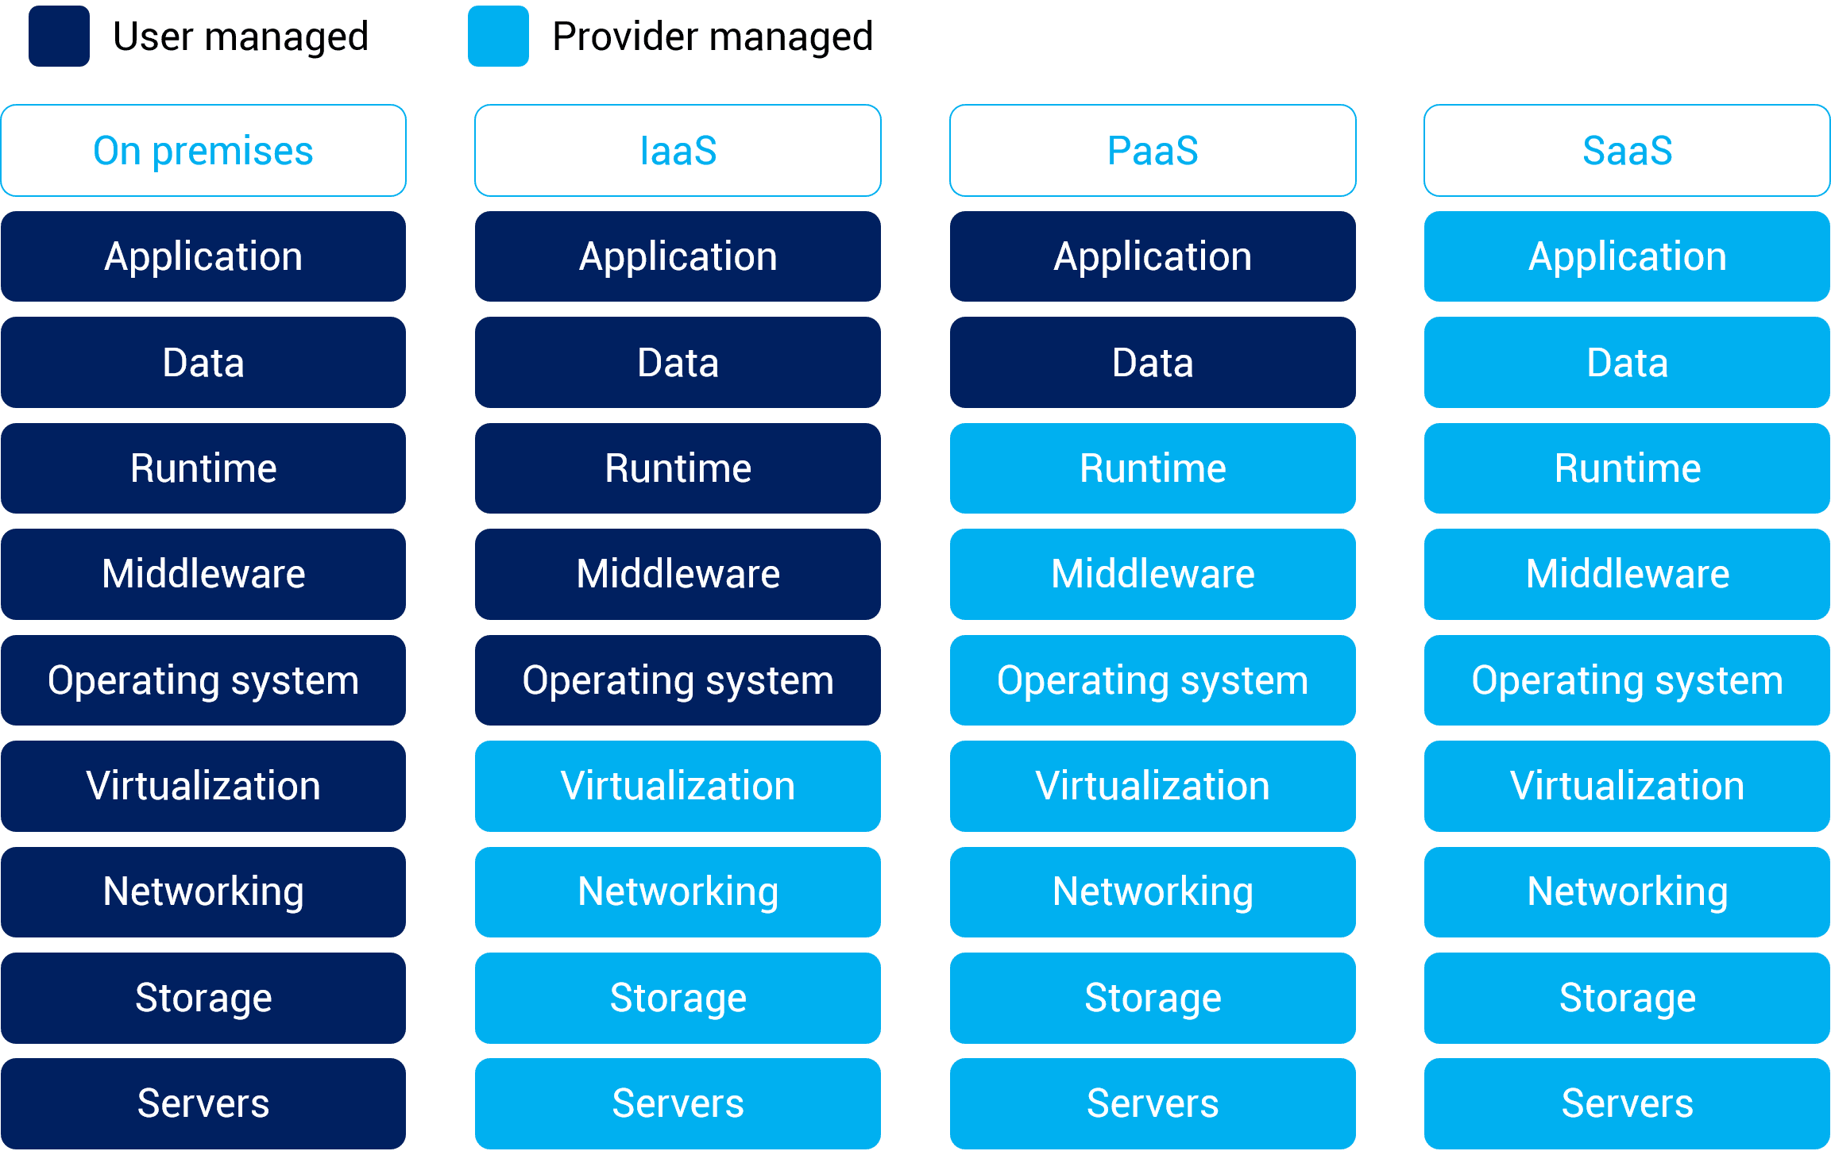

Slide 46
SaaS | PaaS | IaaS
Examples of SaaS are Google Workspace, Google apps, Netflix, Instagram, etc. | Examples of PaaS are the Google app engine, Canva, Github, Heroku etc. | Examples of IaaS are VCloud Express, Google Cloud Platform (GCP), IBM Cloud, AWS, etc.

Slide 47
Features of cloud
Certain features of a cloud are essential to enable services that truly represent the cloud computing model and satisfy expectations of consumers, and cloud offerings must be
(i) self-service
(ii) per-usage metered and billed
(iii) elastic
(iv) customizable.

Slide 48
CLOUD INFRASTRUCTURE MANAGEMENT
A key challenge IaaS providers face when building a cloud infrastructure is managing physical and virtual resources, namely servers, storage, and networks
The orchestration* of resources must be performed in a way to rapidly and dynamically provision resources to applications
The software toolkit responsible for this orchestration is called a virtual infrastructure manager.
Notes:
Orchestration is the coordination and management of multiple computer systems, applications and/or services, stringing together multiple tasks in order to execute a larger workflow or process.

Slide 49
Cloud infrastructure consists of all of the hardware and software elements needed for cloud computing, including:
Compute (server)
Networking
Storage
Virtualization resources
Cloud infrastructure types usually also include a user interface (UI) for managing these virtual resources.

Slide 50
What is cloud infrastructure management?
Cloud infrastructure management comprises the processes and tools needed to effectively allocate and deliver key resources when and where they are required.
The UI, or dashboard, is a good example of such a tool; it acts as a control panel for provisioning, configuring and managing cloud infrastructure.

Slide 51
Cloud infrastructure management tools offer some combination of the following features:
Provisioning and configuration:
Developers, systems engineers and other IT professionals use these tools to set up and configure the hardware and software resources they need.

Slide 52
2. Visibility and monitoring:
Cloud infrastructure management tools allow operators to “see” their environments. More importantly, they include or integrate with monitoring tools that:
Check system health
Deliver real-time alerts and notifications
Create reporting and analytics

Slide 53
3. Resource allocation: Related to cost optimization, resource allocation features enable granular control over how users consume cloud infrastructure, including self-service provisioning.
4. Cost optimization: Managing costs is a critical capability of cloud infrastructure management tools.

Slide 54
5. Automation: Cloud infrastructure management tools sometimes offer automation capabilities for various operational tasks, such as configuration management, auto-provisioning and auto-scaling.

Slide 55
VMware Cloud on AWS provides several mechanisms to configure and adjust the allocation of CPU and memory resources for virtual machines running within it.

Slide 56
Virtual Infrastructure Management
Vmware vSphere Management: managed with the Vmware vSphere Client or Vmware vSphere web services SDK.
Vmware vSphere vMotion: provides performance best practices.
Vmware vSphere Distributed Resource Scheduler: practices and configuration recommended by Vmware for optional performance.

Slide 57
4. Vmware vSphere high availabilty: minimizes virtual machine downtime by monitoring hosts, datastores, virtual machines, or applications within virtual machine.
5. Vmware Virtual SAN: Vmware Cloud on AWS uses Vmware VSAN storage, allowing storage resources attached directly to the hosts to be used for distributed storage and accessed by multiple other hosts.

Slide 58
Features of infrastructure manager
Virtualization Support-The multi-tenancy aspect of clouds requires multiple customers with disparate requirements to be served by a single hardware infrastructure. Virtualized resources (CPUs, memory, etc.) can be sized and resized with certain flexibility.
Self-Service, On-Demand Resource Provisioning-Self-service access to resources has been perceived as one the most attractive features of clouds.

Slide 59
Multiple Backend Hypervisors- Different virtualization models and tools offer different benefits, drawbacks, and limitations. Thus, some virtual infrastructure managers provide a uniform management layer.
Storage Virtualization- Virtualizing storage means abstracting logical storage from physical storage. By consolidating all available storage devices in a data center

Slide 60
Dynamic Resource Allocation- Increased awareness of energy consumption in data centers has encouraged the practice of dynamic consolidating VMs in a fewer number of servers.
High Availability and Data Recovery- The high availability (HA) feature of VI managers aims at minimizing application downtime and preventing business disruption.

Slide 61
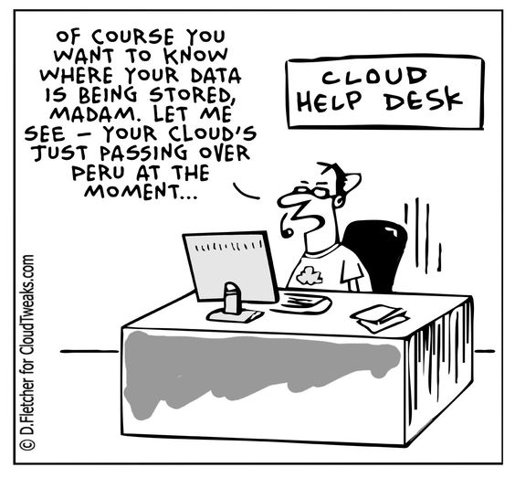

Slide 62
Characteristics of cloud
On-demand self-services: The Cloud computing services does not require any human administrators, user themselves are able to provision, monitor and manage computing resources as needed.
Broad network access: The Computing services are generally provided over standard networks and heterogeneous devices.

Slide 63
Rapid elasticity: The Computing services should have IT resources that are able to scale out and in quickly and on as needed basis. Whenever the user require services it is provided to him and it is scale out as soon as its requirement gets over.
Resource pooling: The IT resource (e.g., networks, servers, storage, applications, and services) present are shared across multiple applications and occupant in an uncommitted manner.

Slide 64
Measured service: The resource utilization is tracked for each application and occupant, it will provide both the user and the resource provider with an account of what has been used. This is done for various reasons like monitoring billing and effective use of resource.

Slide 65
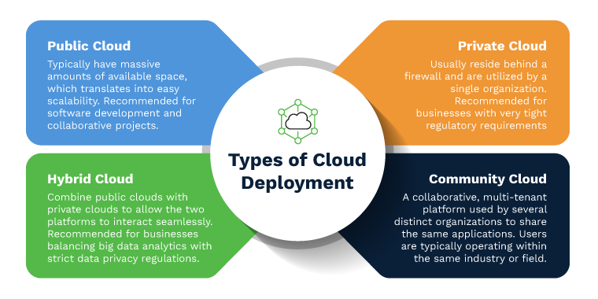

Slide 66
Cloud Deployment Models
Cloud deployment models refer to the ways in which cloud computing resources are organized, accessed, and managed.
Cloud Deployment models are:
Public Cloud
Private Cloud
Hybrid Cloud
Community Cloud

Slide 67
Public Cloud
Public clouds are owned and operated by third-party providers.
They offer resources and services to multiple customers over the internet.
Resources are shared among various users, leading to cost-efficiency and scalability.
Public Cloud is less secure.

Slide 68
Examples of Public Cloud:
Amazon Web Services (AWS): Offers a wide range of cloud services, including computing power, storage, and databases.
Microsoft Azure: Provides a variety of services, including virtual machines, AI, and analytics tools.
Google Cloud Platform (GCP): Offers cloud computing and storage services, as well as machine learning and big data analytics.

Slide 69
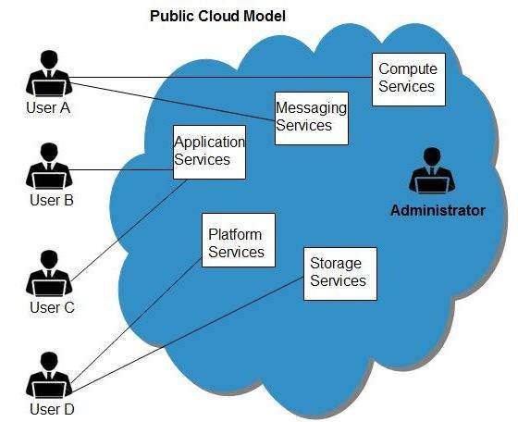
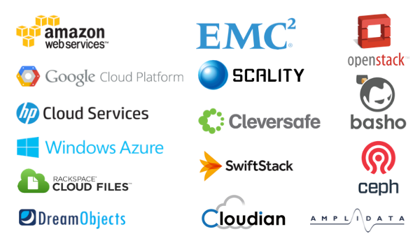

Slide 70
Private Cloud
Private clouds are dedicated to a single organization.
They can be managed internally or by a third party and offer greater control, customization, and security compared to public clouds.
Examples:
A company setting up its own data center with virtualization technology for internal use.
A government agency using a private cloud to host sensitive data and applications.

Slide 71
Example
Amazon Virtual Private Cloud
OpenStack
Vmware etc.

Slide 72
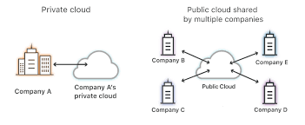
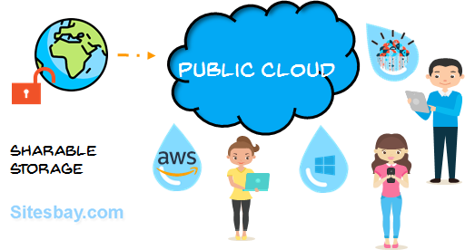

Slide 73
Hybrid Cloud:
Hybrid clouds combine elements of both public and private clouds.
They allow data and applications to be shared between them while maintaining certain workloads in each type of cloud.
A hybrid cloud is a cloud computing environment that uses a mix of on-premises, Private Cloud and third-party Public Cloud services with Coordination between these platforms.

Slide 74
Examples:
An e-commerce company hosting its website on a public cloud but keeping customer payment data on a private cloud for security reasons.
A research institution using a public cloud to analyze large datasets but keeping confidential research results in a private cloud.

Slide 75
Examples of hybrid cloud platforms include AWS Outposts, Azure Stack, Azure Arc, Microsoft Azure VMware Solution, Google Anthos, Nutanix Cloud Infrastructure, Nutanix Cloud Clusters, VMware Cloud Foundation, and VMware Cloud on AWS.

Slide 76
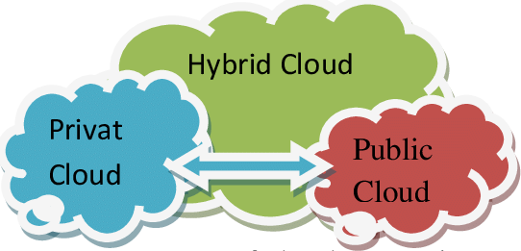

Slide 77
Community Cloud
Community clouds are shared among several organizations with common interests, such as regulatory concerns or industry-specific requirements.
These organizations collaborate to define and manage the shared cloud infrastructure.
It is owned, managed, and operated by one or more organizations in the community, a third party, or a combination of them

Slide 78
Examples:
Healthcare organizations sharing a community cloud to manage patient records while adhering to industry-specific regulations (HIPAA compliance).
Financial institutions collaborating on a community cloud to address their specific security and compliance needs.

Slide 79
Another example of community cloud computing is the scientific research sector. Research organizations with common interests require a large, distributed infrastructure for effective and efficient sharing of data.

Slide 80
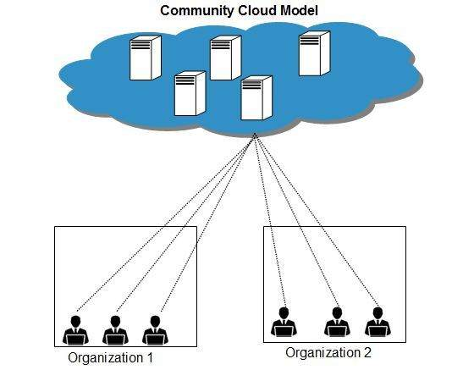

Slide 81
Multi-Cloud:
Multi-cloud involves using services from multiple cloud providers.
This approach aims to avoid vendor lock-in, increase redundancy, and optimize performance.

Slide 82
Examples:
An e-commerce platform using AWS for computing resources and GCP for its machine learning capabilities.
A gaming company utilizing Azure for its development environment and AWS for scalable server hosting.

Slide 83
MCQs
1. What is Cloud Computing? a) Cloud Computing means providing services like storage, servers, database, networking, etc b) Cloud Computing means storing data in a database c) Cloud Computing is a tool used to create an application d) None of the mentioned

Slide 84
2. Which of the following is the application of cloud computing? a) Adobe b) Paypal c) Google G Suite d) All of the above

Slide 85
3. Which of the following are the features of cloud computing? a) Security b) Availability c) Large Network Access d) All of the mentioned

Slide 86
4. Which of the following is a type of cloud computing service? a) Service-as-a-Software (SaaS) b) Software-and-a-Server (SaaS) c) Software-as-a-Service (SaaS) d) Software-as-a-Server (SaaS)

Slide 87
Answer: c Explanation: Software as a Service, is the most widely used choice for enterprises. SaaS makes use of the internet to offer apps to consumers that are controlled by a third-party vendor.

Slide 88
5. Which of the following is an example of the cloud? a) Amazon Web Services (AWS) b) Dropbox c) Cisco WebEx d) All of the above

Slide 89
Note: Webex by Cisco is an American company that develops and sells web conferencing, videoconferencing and contact center as a service applications.

Slide 90
6. Which of the following is an example of a PaaS cloud service? a) Heroku b) AWS Elastic Beanstalk c) Windows Azure d) All of the above

Slide 91
Answer: d Explanation: PaaS stands for Platform-as-a-Service. In PaaS, the users receive hardware or software tools from the users on the internet. AWS Elastic Beanstalk, Windows Azure, Heroku are example of a PaaS service.

Slide 92
7. Which of the following is the correct statement? a) Cloud computing presents new opportunities to users and developers b) Service Level Agreements (SLAs) is small aspect of cloud computing c) Cloud computing does not have impact on software licensing d) All of the mentioned

Slide 93
Answer: a Explanation: Because it is based on the paradigm of a shared multi-tenant utility.

Slide 94
8. Cloud computing is a concept that involves pooling physical resources and offering them as which sort of resource? a) cloud b) real c) virtual d) none of the mentioned

Slide 95
Answer: c Explanation: Cloud computing means providing services like storage, servers, database, networking, etc. over the internet. It is a new model for provisioning resources, for staging applications, and for platform-independent user access to services.

Slide 96
9. Which of the following is the Cloud Platform provided by Amazon? a) AWS b) Cloudera c) Azure d) All of the mentioned

Slide 97
Answer: a Explanation: Amazon Web Services (AWS), an Infrastructure as a Service (IaaS) offering that allows users to rent virtual machines on Amazon’s own infrastructure, is one of the most successful cloud-based enterprises.

Slide 98
10. Which of the following is not a property of cloud computing? a) virtualization b) composability c) scalability d) all of the mentioned

Slide 99
Answer: b Explanation: Virtualization is achieved by creating a virtual environment of storage devices and server operating systems. Composability is the ability to build applications from component parts.

